Slide 1
Personalized Video Thumbnails
Matthew Fong
Kai Wu
Xueqin Zhang

Slide 2
Motivation
Notes:
Start at 0

Slide 3
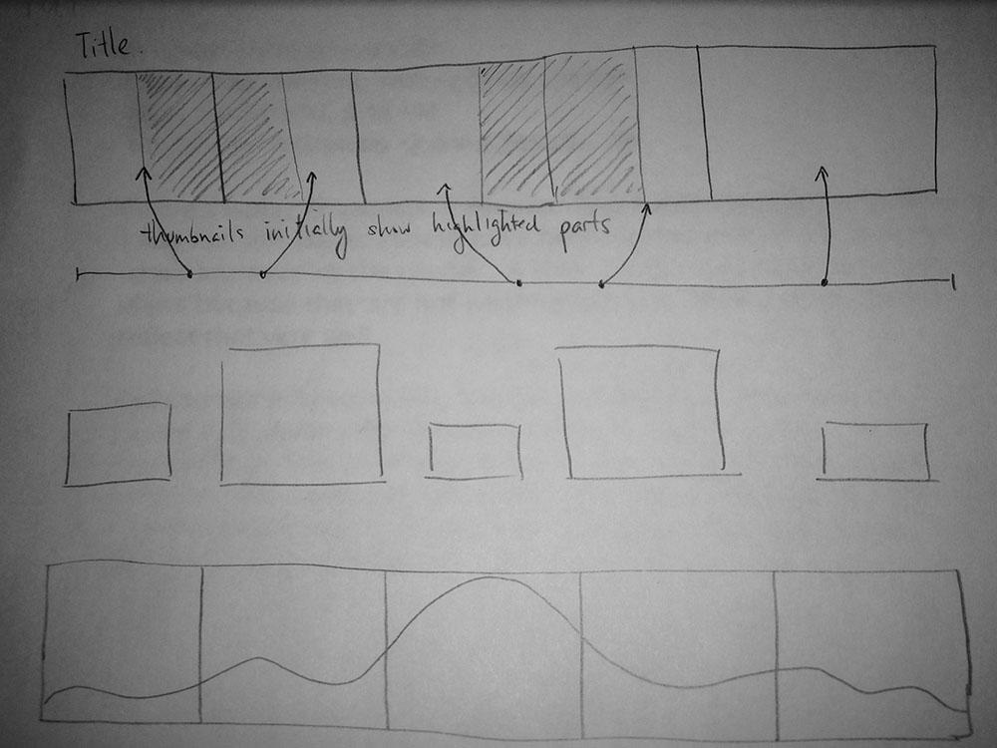
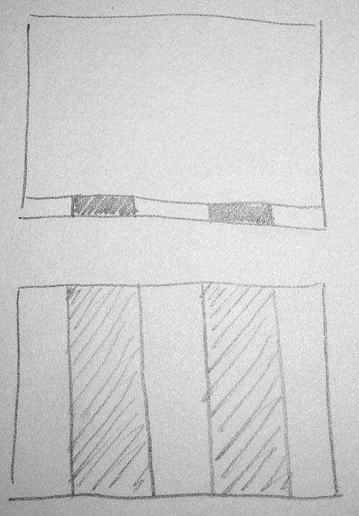
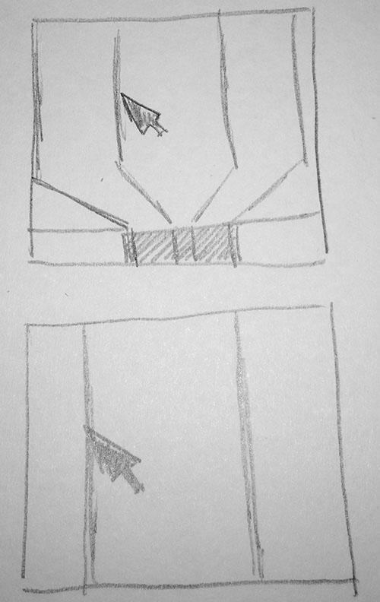
Prototypes

Slide 4
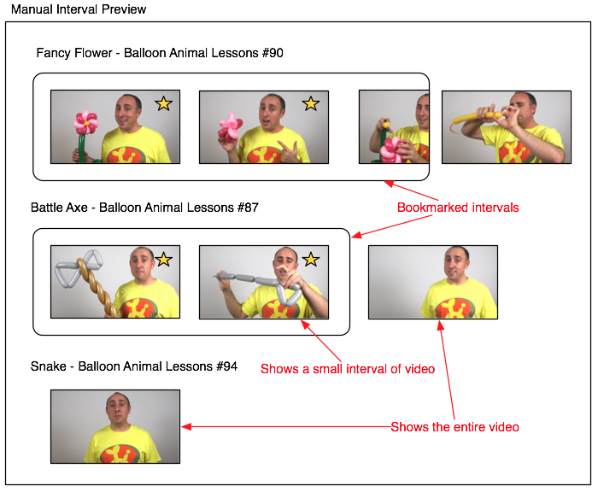
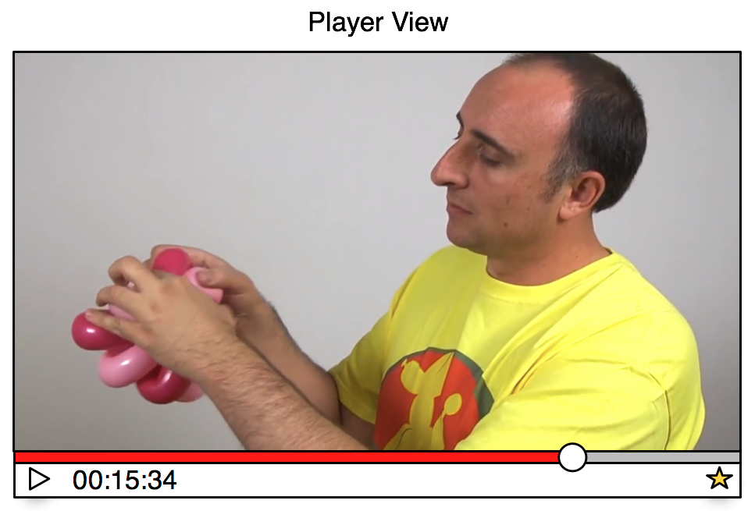
Prototypes

Slide 5
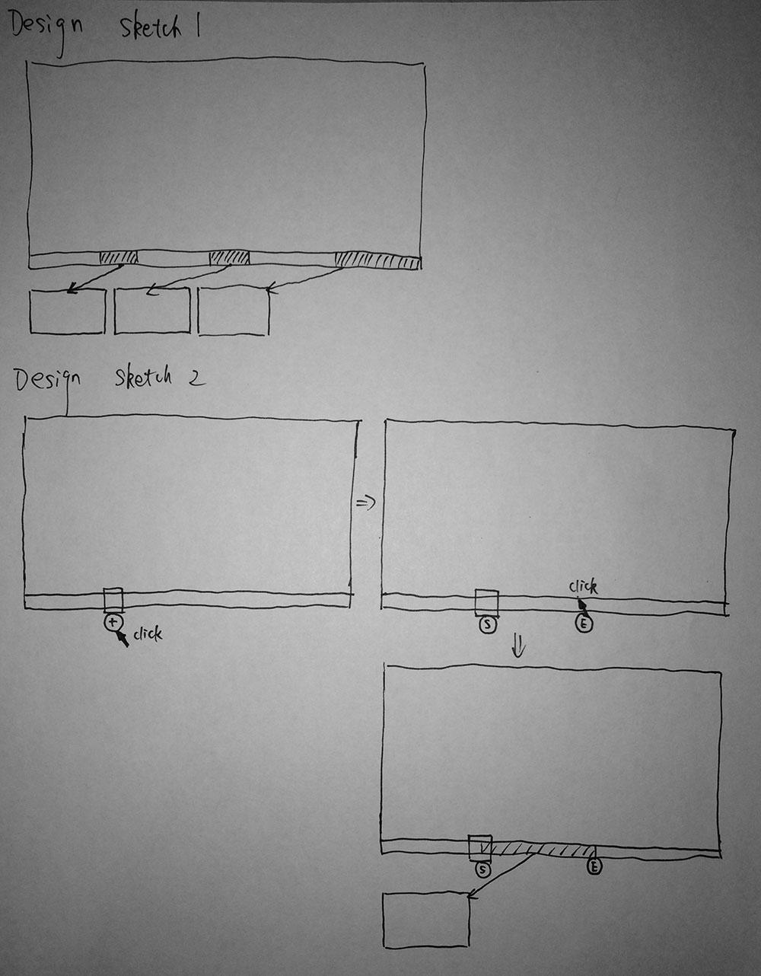
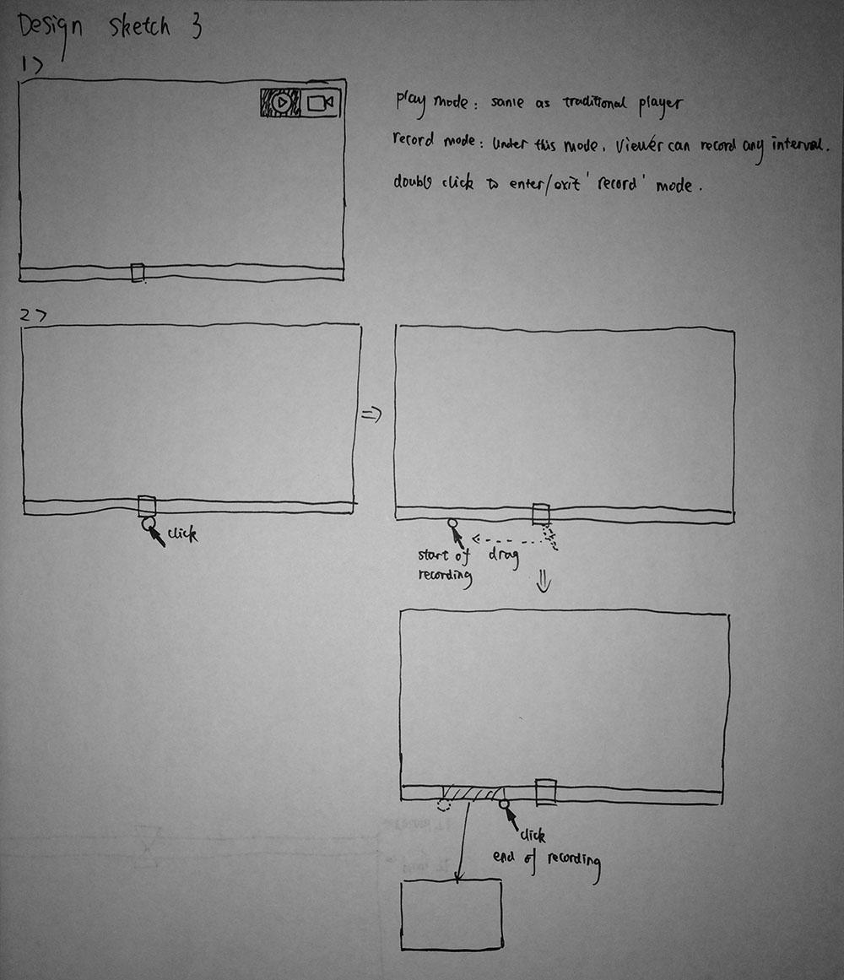
Rejected Prototypes

Slide 6
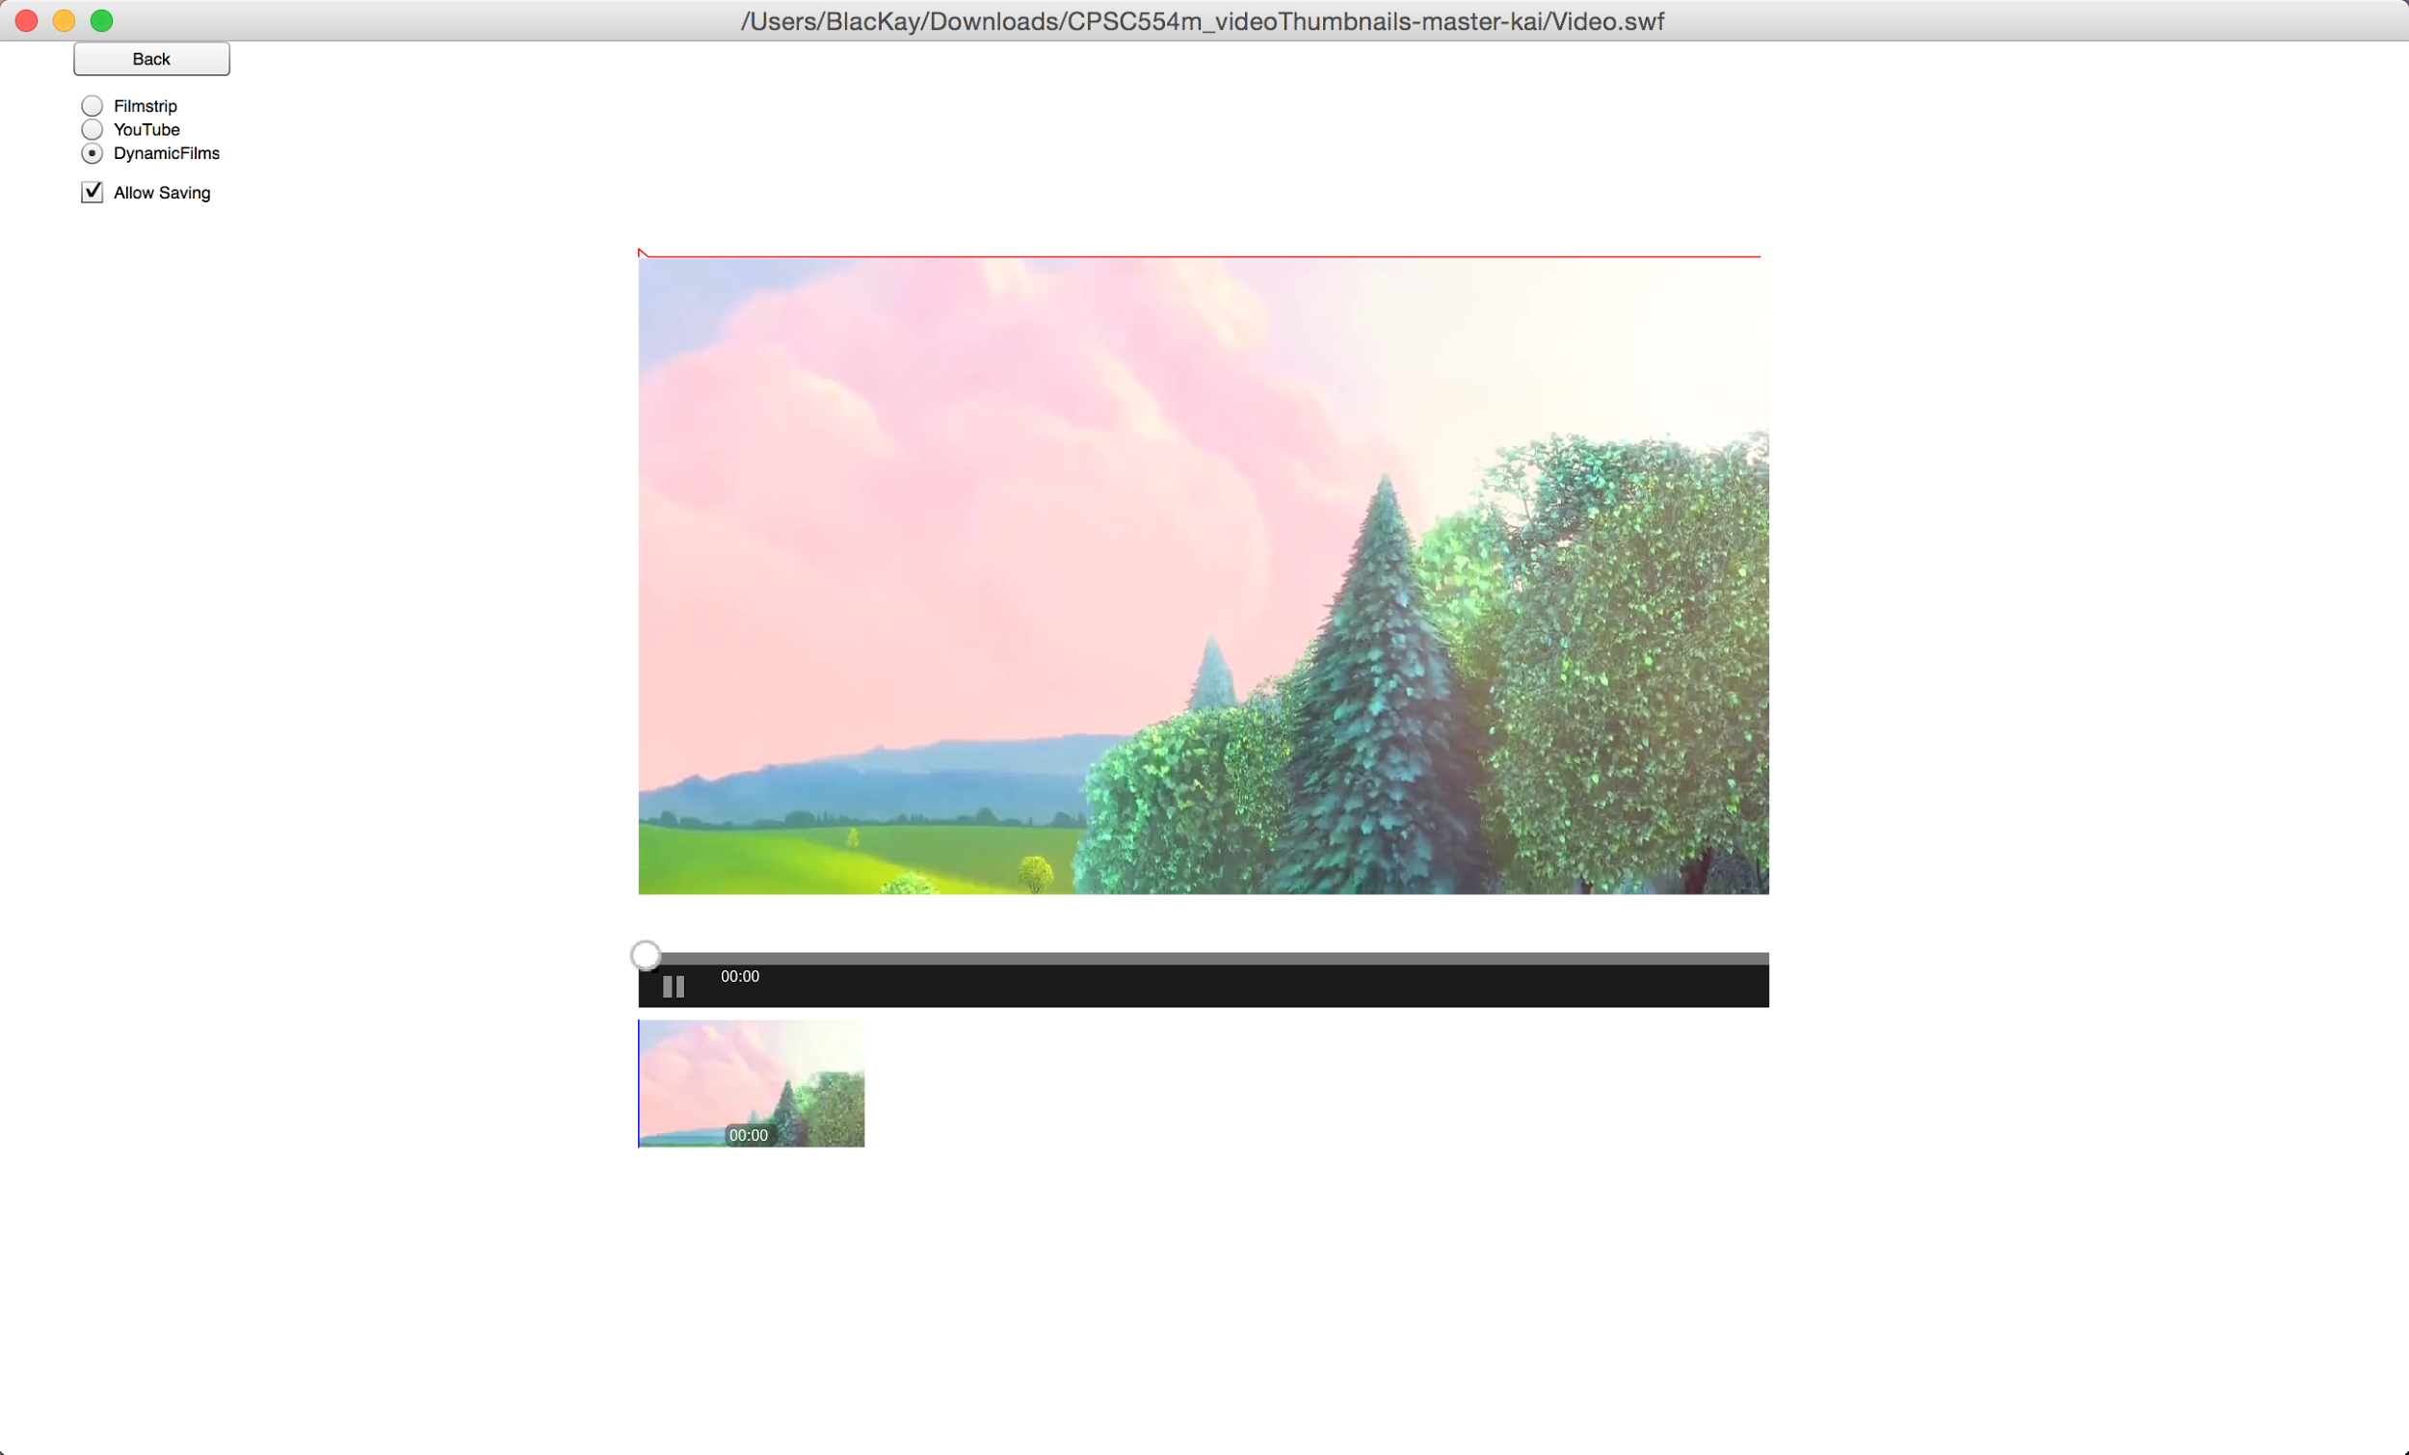
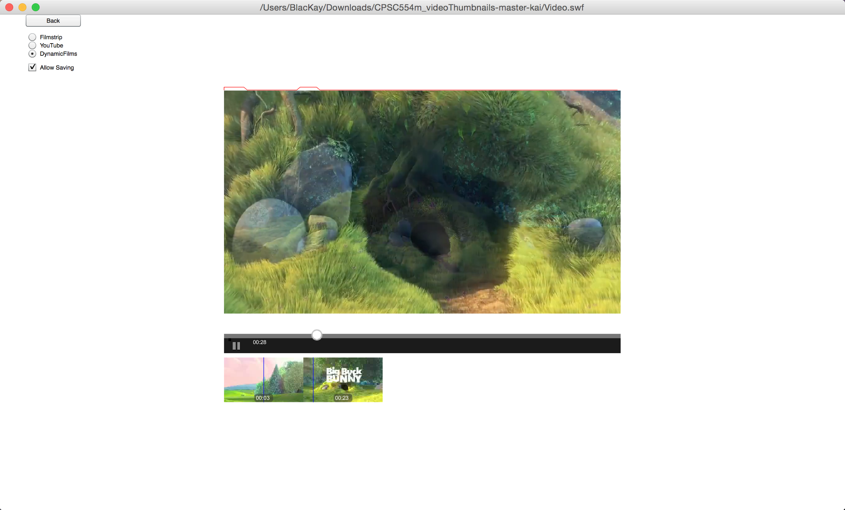
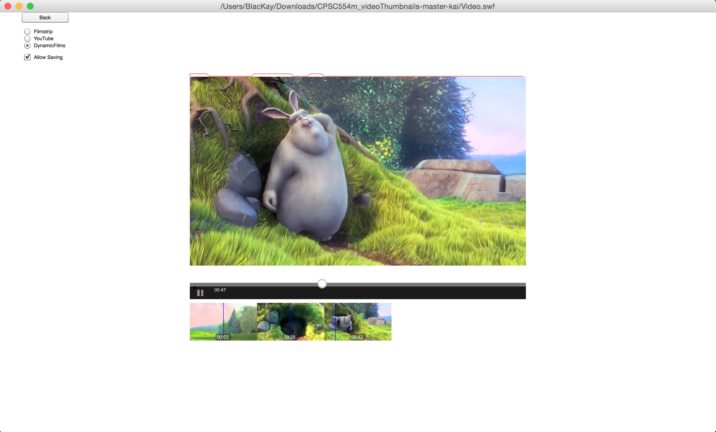
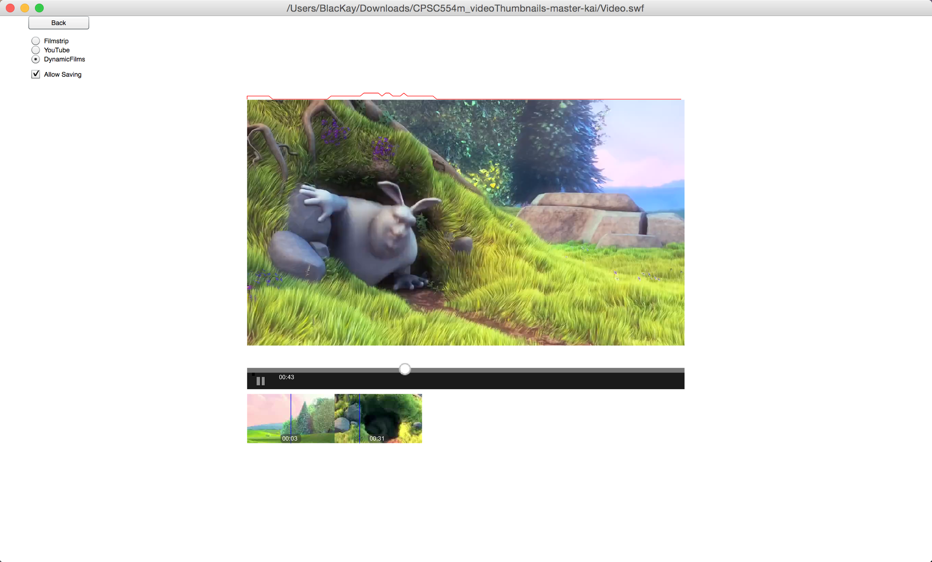
Rejected Prototypes
dynamic
filmstrip

Slide 7
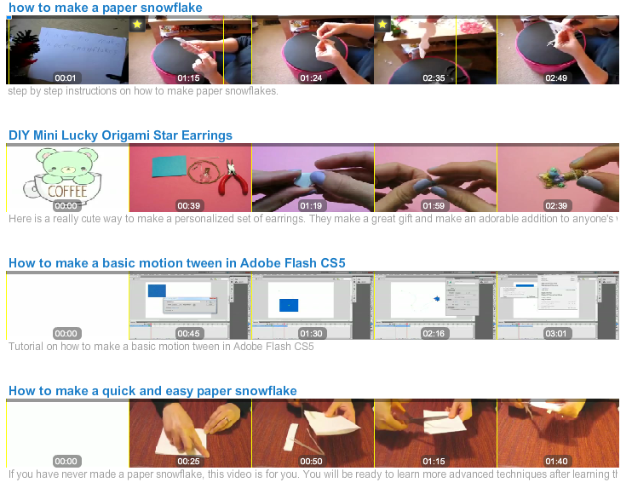
High Fidelity Prototype
Notes:
Video: 1:23

Slide 8
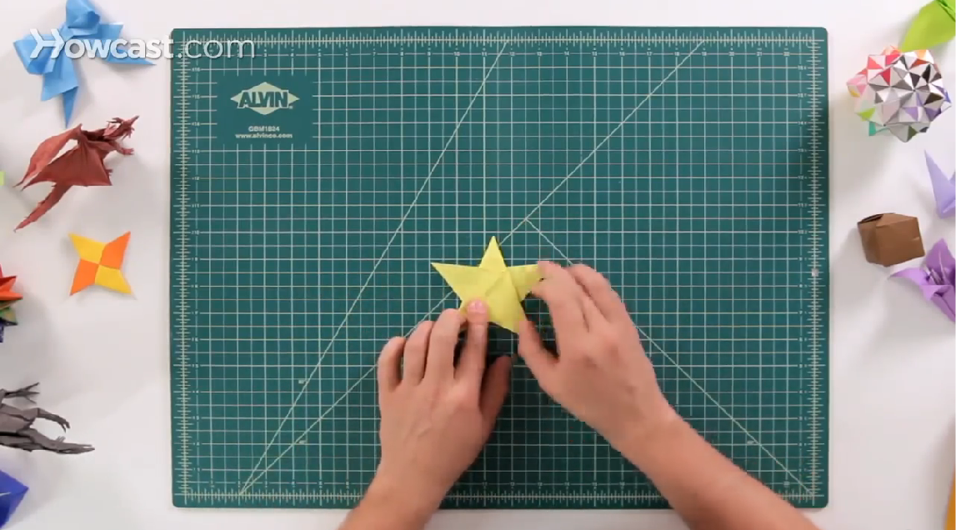
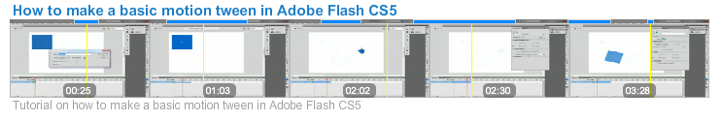
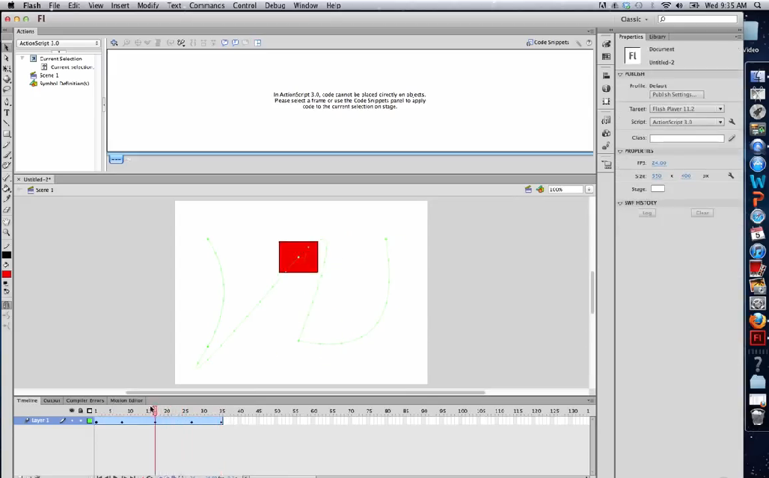
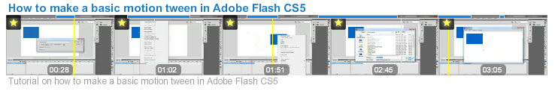
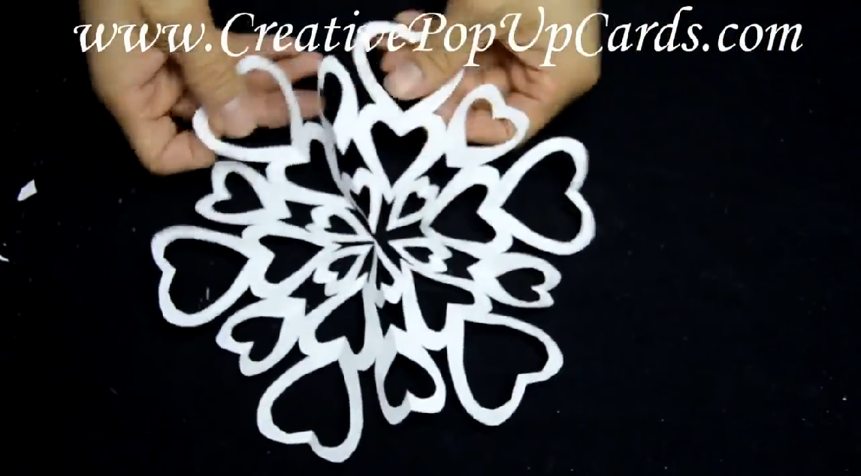
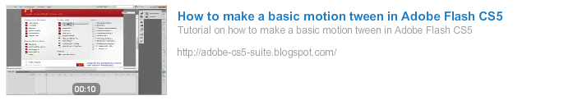


User Evaluation - Experiment
Two-way within subjects design
Independent Variables: Technique and Video
Dependent Variables: Time taken and Number of Errors

Slide 9

User Evaluation - Hypotheses
Automatic
Mixed
YouTube
H1: Time Taken
Least to most
Mixed
Automatic
YouTube
H2: Error Rate
Least to most
Automatic
Mixed
YouTube
H3: Preference
Most to least

Slide 10
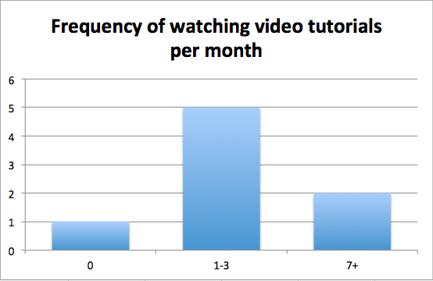
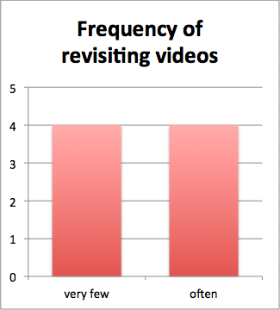
User Evaluation - Participants
8 participants
5 male, 3 female
Ages 19 - 61 (median = 23)

Slide 11
User Evaluation - Procedure
Watched three videos and followed the tutorials

Slide 12
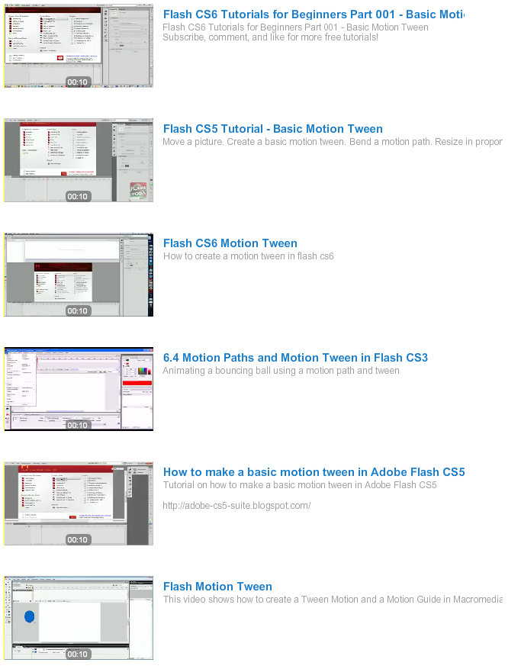
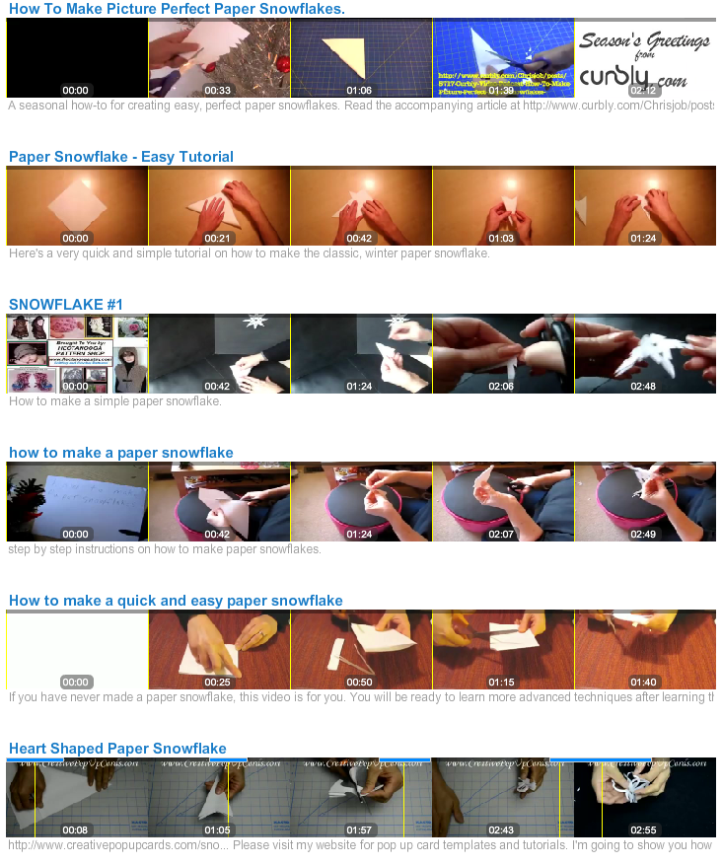
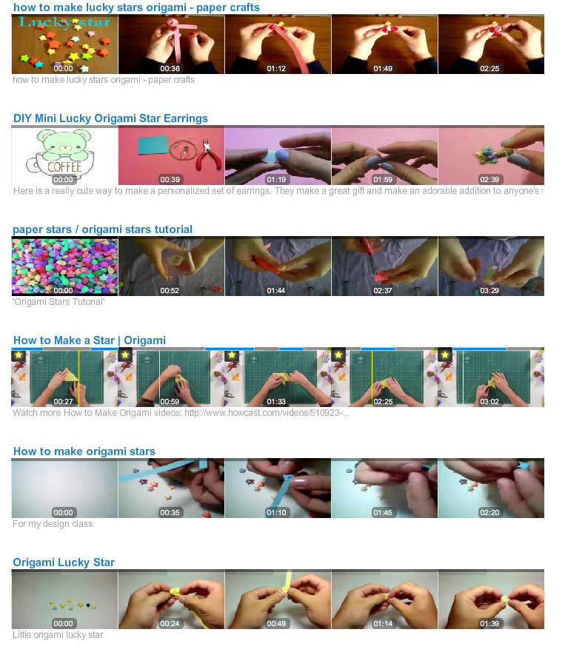
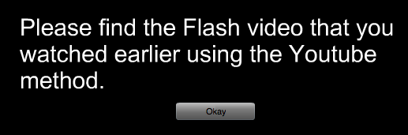
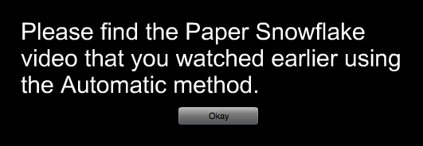
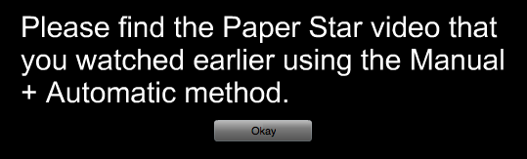
User Evaluation - Procedure

Slide 13
User Evaluation - Procedure
Selection task
12 X, first three results are thrown out
9 actual trials: each video is matched with each method
Video to select order are randomized
Distraction videos order are randomized

Slide 14
Video of participants
Notes:
Video: 2:50

Slide 15
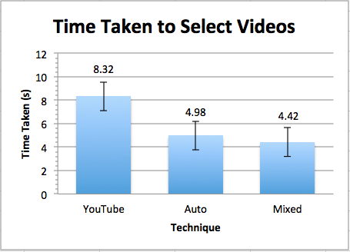
Quantitative Results
Auto was significantly faster than YouTube (p = .015)
Mixed was significantly faster than YouTube (p = .009)
Very low error rates (2 errors among all participants for each method)
Participant usability evaluation: no significant results among 3 methods

Slide 16
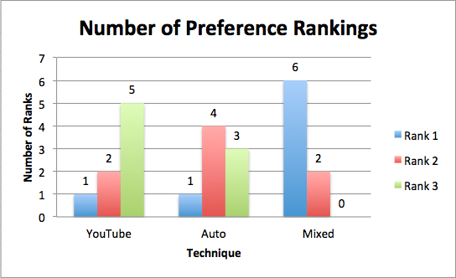
Quantitative Results
Method preference ranking:
Mixed had a significantly higher ranking than Auto (p = .033) and YouTube (p = .026)

Slide 17
Qualitative Results
P1
“Mixed gives me control over what I would like to choose to remind myself of the clip. The bookmarking idea (and the yellow symbol) really stood out and helped me recall what I just watched. Also, when I was bookmarking, I had to really think about which part of the video would offer the biggest impression of that particular video. ”
P7
“This looks cool, but the automatic method doesn't seem useful, and I'd like a manual method.”
P5
“I rarely bookmark although it can help find the feature thumbnails. ”

Slide 18


User Evaluation - Hypotheses
Automatic
Mixed
YouTube
H1: Time Taken
Least to most
Mixed
Automatic
YouTube
H2: Error Rate
Least to most
Automatic
Mixed
YouTube
H3: Preference
Most to least

Slide 19
User Evaluation - Hypotheses
1. Automatic
1. Mixed
2. YouTube
H1: Time Taken
Least to most
1. Mixed
1. Automatic
1. YouTube
H2: Error Rate
Least to most
1. Mixed
2. Automatic
3. YouTube
H3: Preference
Most to least

Slide 20
CONCLUSIONS
Overall, the mixed and automatic methods are faster than the YouTube method to find previously seen videos.
The mixed method gives the users more control of what thumbnails to be shown over automatic one although it will have more operation cost.
Despite this, users prefer the mixed method over the automatic method

